Slide 1

Public Involvement Overview
This presentation is for the project ID 8910-03-08/78 on County D between County O and County S North, Town of Delmar, Chippewa County. This project corridor is approximately 5 miles long.
An in-person meeting is not planned at this time.
All meeting materials, including the handout with a comment form, are posted on the design website for this project, which can be found at: https://www.chippewacountywi.gov/government/highway/about-us/news-press-releases https://www.co.chippewa.wi.us/government/highway/about-us-new/news-pressreleases-new
If you have any questions, please contact design Project Manager, Kevin Meyer at (715) 299-1894 or Chippewa County Highway Department Project Manager, Fred Anderson at (715) 738-2610.

Slide 2
Public Involvement
County D
County O to County S North
Boyd – Estella
Chippewa County
Public Comment Period: Through October 1, 2025

Slide 3
Project Team
CORRE, Inc.
Kevin Meyer, P.E. – Design Consultant
Chippewa County Highway Department
Fred Anderson, P.E. – Project Manager

Slide 4
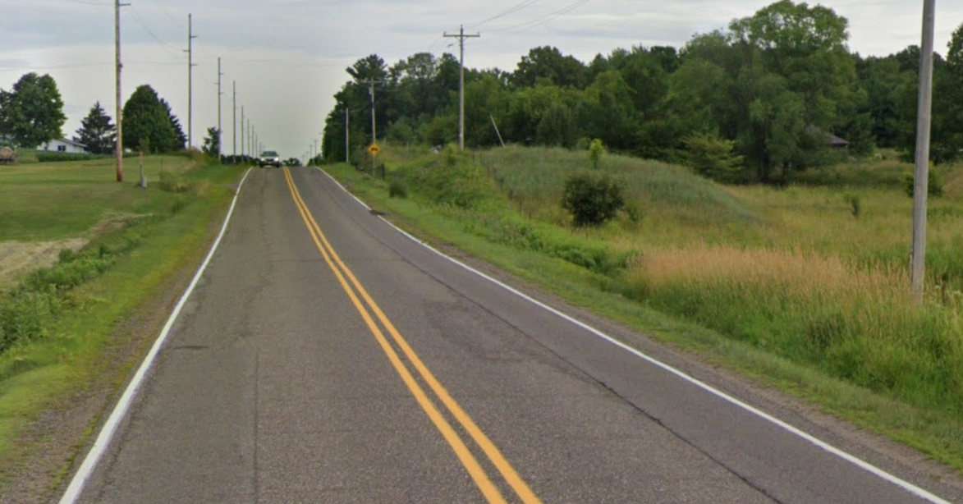
Event Objectives
Project Limits and Definition
Project Purpose and Need
Proposed Improvements
Real estate needs
Construction Impacts
Project Schedule
Contact Information
Questions and Input

Slide 5
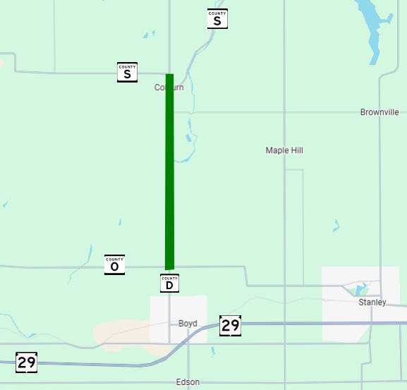
Project Limits and Definition
Project ID 8910-03-08/78
Pavement Replacement Project
Project is located along 5 miles of County D north of the village of Boyd
See location on map.

Slide 6
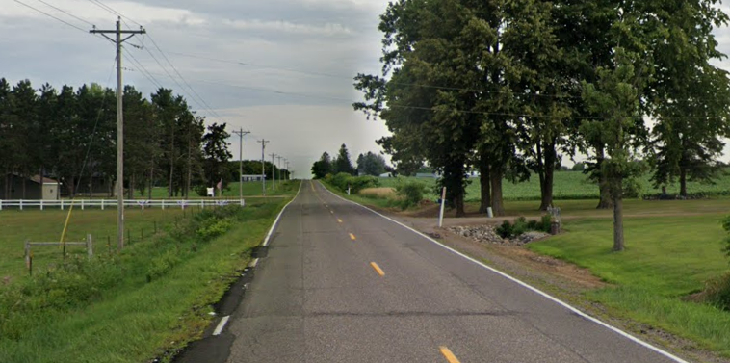
Project Purpose and Need
Proposed improvements on the roadway will address:
Deteriorated, cracked and rutted pavement
Substandard guard rail

Slide 7
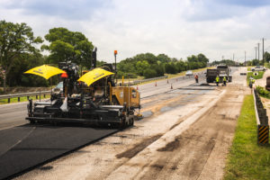
County D Proposed Improvements
Proposed improvements will include:
Pulverizing existing pavement
Overlaying pulverized material with 4-inches of new asphaltic pavement
Replacing substandard beam guard

Slide 8
Real Estate Needs
Right-of-Way Acquisition is anticipated.
Strips of Temporary Limited Easement (TLE) will be needed to construct side slopes near beam guard.
This will allow the contractor to complete necessary improvements.

Slide 9
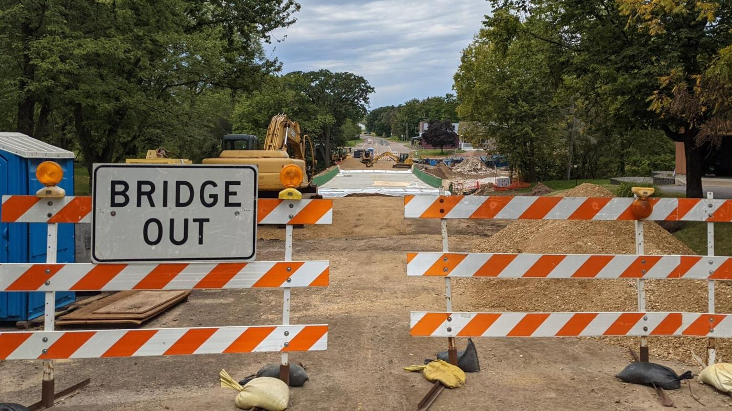
Construction Impacts
County D will remain open to thru traffic
Work will be completed using flagging operations and single lane closures
Existing access to be maintained

Slide 10
Project Schedule
Final design plan completion
November 2027
Construction
Summer 2028 construction season (scheduled)
Work is anticipated to take approximately 8-10 weeks to complete

Slide 11
Design Consultant Contact Information
Kevin Meyer, CORRE, Inc.
(715) 299-1894
kmeyer@correinc.com
Fred Anderson, Chippewa County
(715) 738-2610
fanderson@chippewacountywi.gov

Slide 12
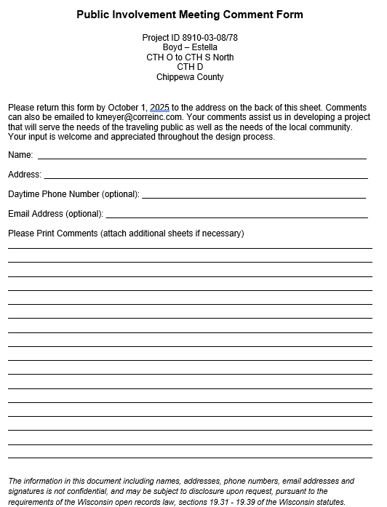
Questions and Input
Submit by October 1, 2025 by:
Mail to:
CORRE, Inc.
1802 Warden Street
Eau Claire, WI 54703
Attn.: Kevin Meyer
Via Email:
kmeyer@correinc.com
kmeyer@correinc.com

